Slide 1

Layers of the Atmosphere
In our atmosphere temperature and pressure change with increasing height.

Slide 2
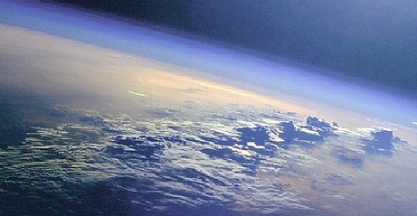
Atmosphere- a layer of gases that surround the earth

Slide 3
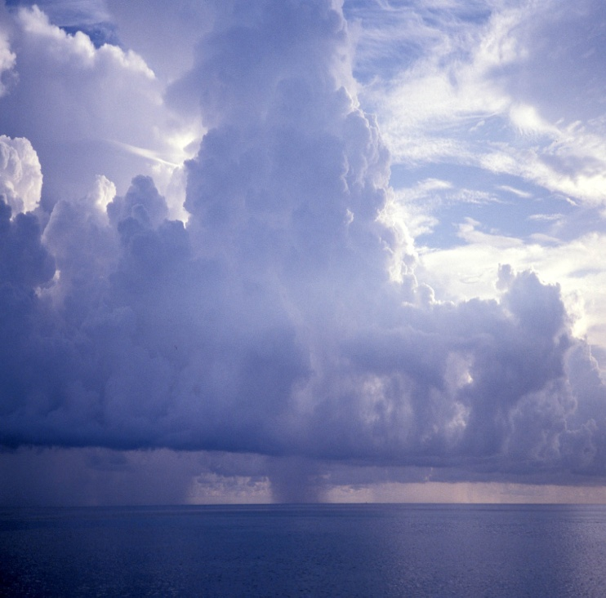
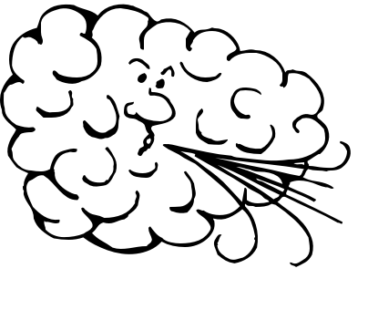


Troposphere
• bottom layer → from Earth’s surface to about 12 kilometers altitude (0 to 7.5 miles)
• where we live & weather happens, clouds form, air moves a lot here →it’s turbulent and well-mixed Tropo = turning or changing
• gets colder with increasing altitude…to about -55⁰ C (-67⁰ F) at the top (tropopause)
Think about how it gets colder on a mountain.

Slide 4
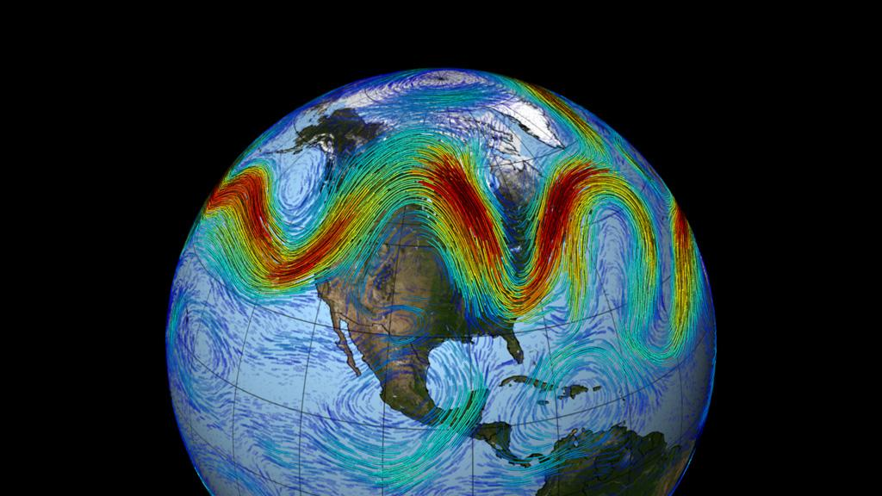
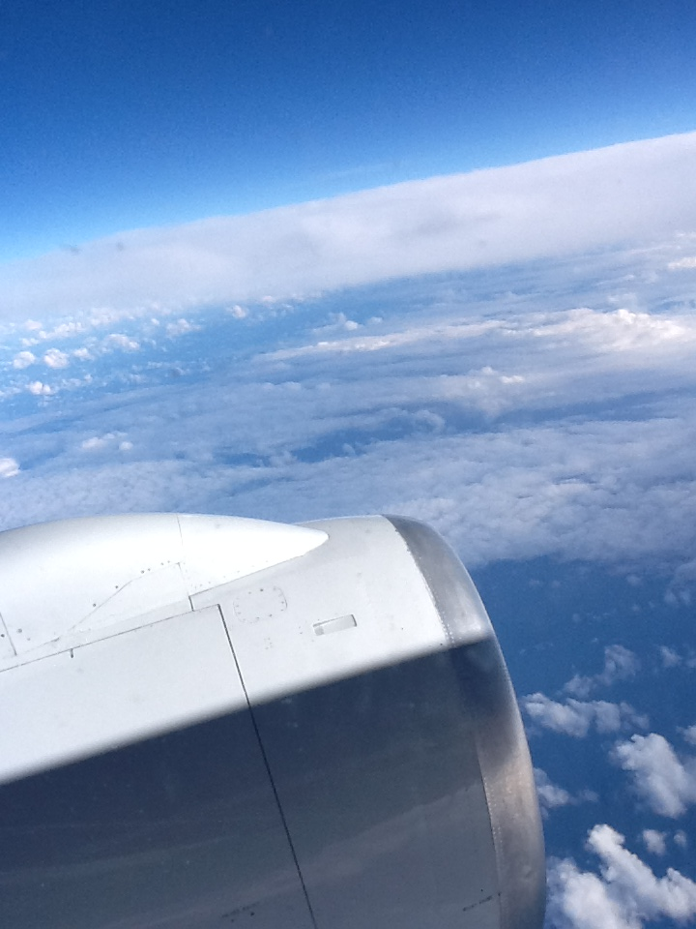
Troposphere
most of atmosphere’s mass is here → the densest layer because gravitational pull is stronger here
Jet stream is in upper troposphere & lower stratosphere…
Airplanes do not fly higher than about 11 km …~7 miles up

Slide 5
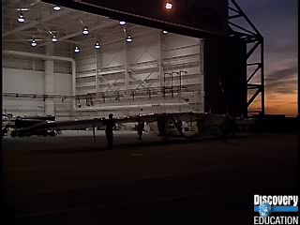
Video clip about flying in the stratosphere Use my username: kendrewi and password: science to access United Streaming.
http://player.discoveryeducation.com/index.cfm?guidAssetId=D23E822Hyperlink

Slide 6
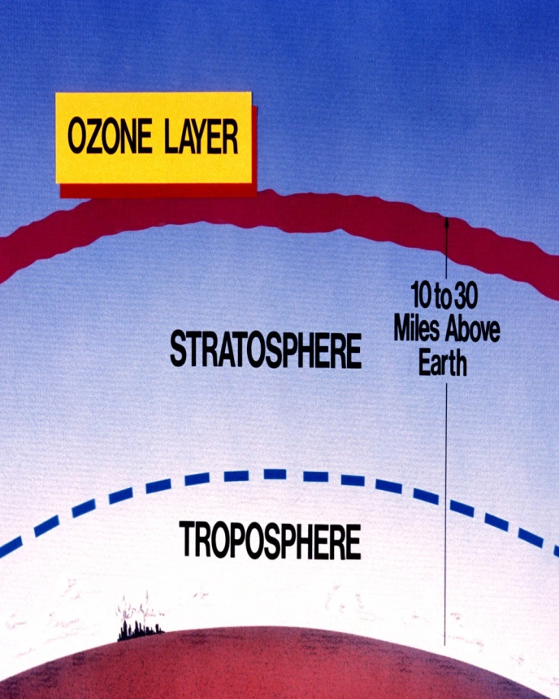
Stratosphere
above the troposphere
You can see where it begins because large cumulonimbus storm clouds reach into and stop at the lower stratosphere
Extends to ~50 km (31 mi)
Way less air pressure here…less mass above, less density and less gravitational force
Strato = layer or “spreading out” ...air does not move a lot here

Slide 7
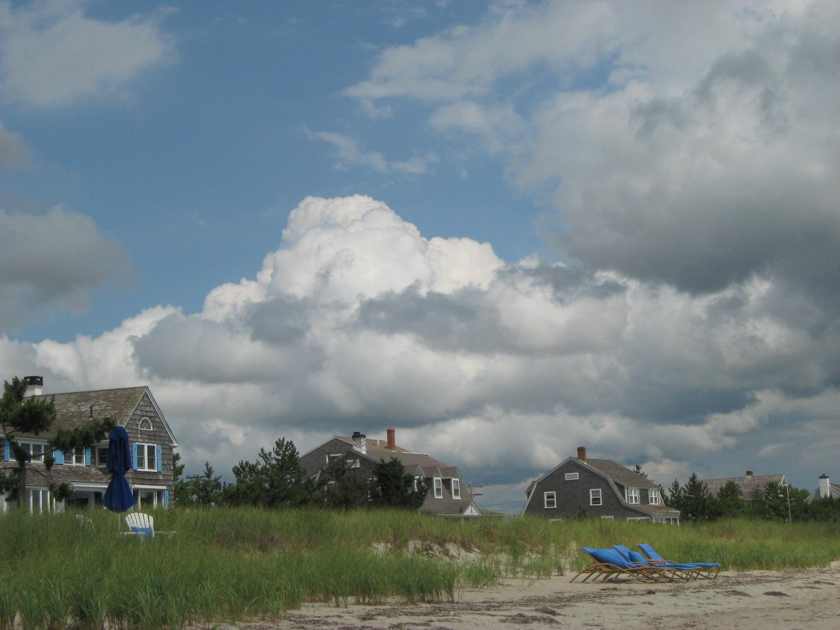

Slide 8
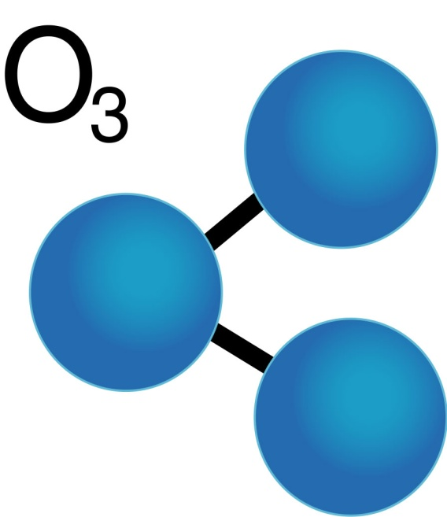
Stratosphere
OZONE is formed in this layer….O₃ absorbs most UV radiation from sun
temperatures increase with altitude in the stratosphere because of ozone.
Is ozone good or bad?
As ozone molecules absorb UV they get energized, move faster and produce heat

Slide 9
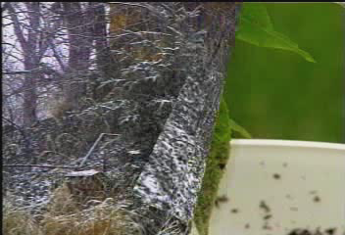
Video clip about ozone!
http://player.discoveryeducation.com/index.cfm?guidAssetId=E320368D-9247-4FDC-9949-3B7E8983E67E&blnFromSearch=1&productcode=DSC

Slide 10

Mesosphere
~50-90 km (31 – 50 mi)
meso = middle
99.9% of mass lies below the mesosphere
Not enough oxygen to breathe but % is still the same (What % is that?)
Most meteoroids burn up here…. the air is very thin, but still dense enough to slow down meteoroids due because of friction

Slide 11
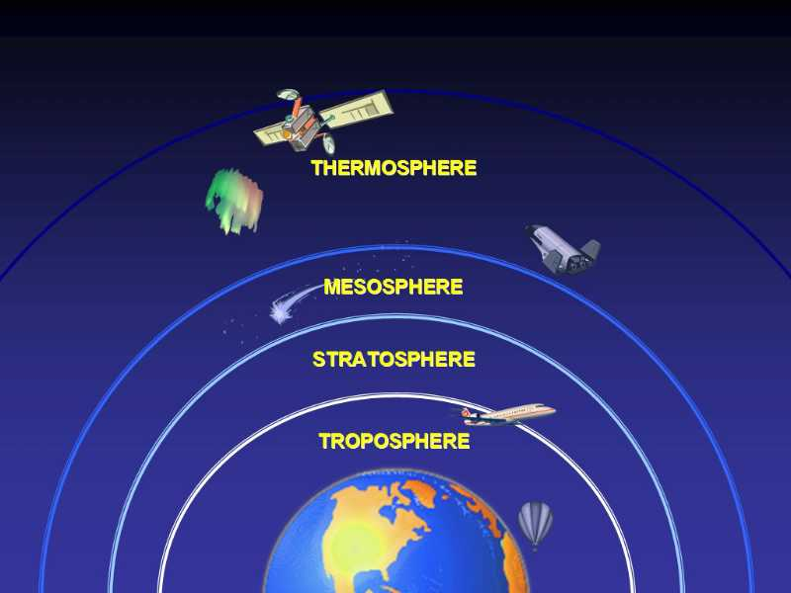
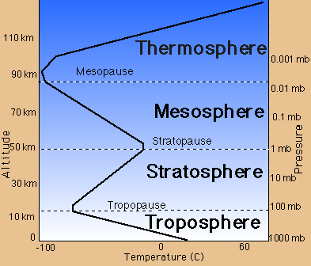
Mesosphere
There is not an ozone layer to cause heating so, temperatures decrease with altitude in the mesophere
Coldest layer! down to -148⁰ F (-100⁰C ) at the mesopause…
What is a “pause”?
What is a “pause”?

Slide 12
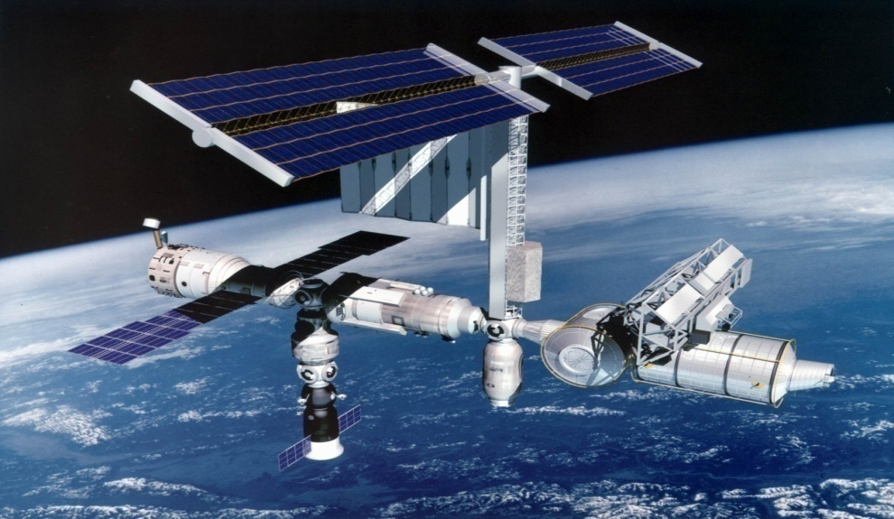
Thermosphere
Above the mesosphere to ~690 km (430 miles)….with no real upper limit → space!
least dense of all layers …. few molecules are far apart & moving fast because of radiation absorption

Slide 13
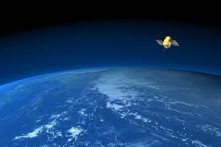
Thermosphere
temps can reach 2,000⁰ C (3,600⁰ F) … but would feel very cold…too few hot molecules to transfer heat
Temperatures can vary greatly here because of solar activity
Thermo = heat
Sometimes divided into two layers : ionosphere and exosphere

Slide 14

Ionosphere
lower part of thermosphere
solar radiation very strong here & is absorbed by the few oxygen & nitrogen molecules resulting in electrically charged gas particles (ions) that cause heat
AM radio waves bounce off these ions and back to earth
Aurora Borealis(Northern Lights) ….glowing ions

Slide 15
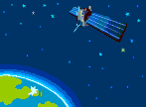
Exosphere
Outer thermosphere & outermost layer of the atmosphere
Exo = “outer” (To infinity & beyond! )
Satellites orbit here
Atoms & molecules
escape into space here
TV & cell phone signals
travel to satellites here
and are bounced back

Slide 16
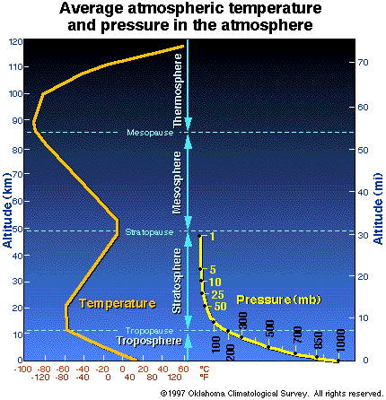
Air Pressure and Height
Temperature and Height
Air pressure always decreases with increasing height. As we move up in the atmosphere there is less mass above us, so the pressure is less, too.
Temperature changes in our atmosphere are more complicated and depend on the energy received by air molecules from radiation. The two main sources of radiation are the sun and earth. Temperature decreases in the troposphere, increases in the stratosphere, decreases in the mesosphere, and increases in the thermosphere.

Slide 17
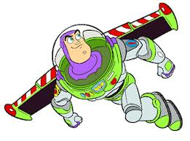
Click Links below:
National Geographic Northern Lights
Mr.Parr - Atmosphere Song

Slide 18

Layers of the Atmosphere
http://player.discoveryeducation.com/index.cfm?guidAssetId=BDC06C08-C65C-4253-8449-54B948C963DA

Slide 19
Works Cited
Discovery Education. (2003). Clouds, storm [Image]. Available from http://www.discoveryeducation.com/
Discovery Education. (2010). Illustration of U.S. Space Station in orbit [Image]. Available from http://www.discoveryeducation.com/
York Films. (2003). All About Auroras: Natures Light Show [Video Segment]. Available from http://www.discoveryeducation.com/
Discovery Education. (2010). Aurora borealis [Image]. Available from http://www.discoveryeducation.com/
Discovery Education. (2004). Flying in Earth's Stratosphere [Video Segment]. Available from http://www.discoveryeducation.com/
Discovery Education. (2004). Ozone layer, location in atmosphere of [Image]. Available from http://www.discoveryeducation.com/
Paul Fuqua. (1993). Ozone: Harmful and Helpful [Video Segment]. Available from http://www.discoveryeducation.com/
Discovery Education. (2005). Elements of Earth Science: Earth's Atmosphere, Weather, and Climate [Full Video]. Available from http://www.discoveryeducation.com/

